Slide 1
Using Respondus LockDown Browser and Monitor for Online Test (Student Guide)
26 August 2020

Slide 2
Using Respondus LockDown Browser and Monitor for Online Test
1. Instructions
2. Trouble shooting
Note: Your will be recording this online test for audit purposes and the recording will be retained until the release of examination results.

Slide 3
Instructions

Slide 4
You must do the following
Install the Respondus Lockdown Browser on your laptop
1
Use Respondus LockDown Browser to take the Practice and Actual Test
2
Answer ‘YES’ for the consent statement before taking the actual test
4
Check that you can complete the test using LockDown Browser and Monitor (with webcam and microphone) before the actual test
3

Slide 5
Student Activities’ Workflow
Taking Online Test in NTULearn
Launch LockDown Browser
Log in to NTULearn
Enter the Course where the test is hosted
Submit Consent to Online Exam Form (for actual Test)
Re-attempt the Test (for mock/practice test only)
Submit the Test attempt
Take the Test, save the attempt regularly
Log out and re-login to continue the test
Log out of NTULearn and close LockDown Browser
If an error occur

Slide 6
Setting Up Respondus Lockdown Browser
Respondus LockDown Browser MUST be used to access the online test in NTULearn.
You will need to have system administrator access to the computer running the LockDown Browser.
The mock test is available in the CITS Demo and Test Site. Please self-enroll into the course to check that you are able to use LockDown Browser to take the test.
If you encounter any problem in using the LockDown Browser to access/complete the mock test, please log a case in the Student ServiceNow Portal so that we can follow up with you to resolve the issue.

Slide 7
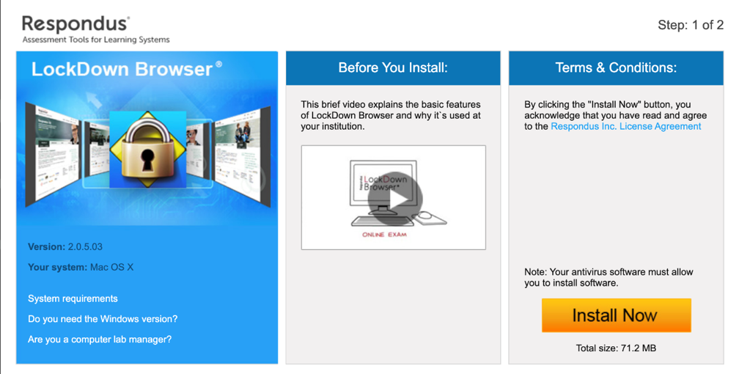
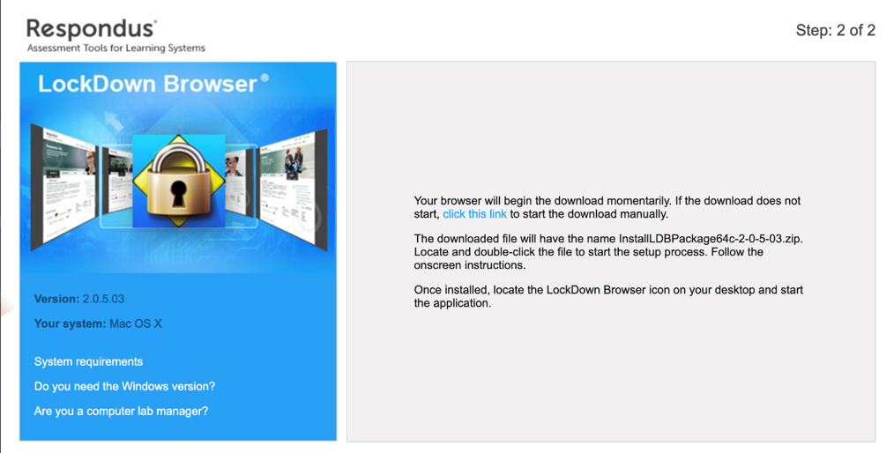
Respondus Quick e-Guide: Installing Respondus LockDown Browser
Respondus LockDown Browser is a web browser for students to take online tests in NTULearn in a lockdown test environment. This is to prevent students from accessing other web resources, messaging tools and computer functions such as Print and Print Screen during the test.
3
2
Steps
Go to the website https://download.respondus.com/lockdown/download.php?id=946716216.
Click Install Now to download the installer.
Launch the installer and follow the on-screen instructions to install the application.
Important:
You need System Administrator access right to the computer when using LockDown Browser.

Slide 8
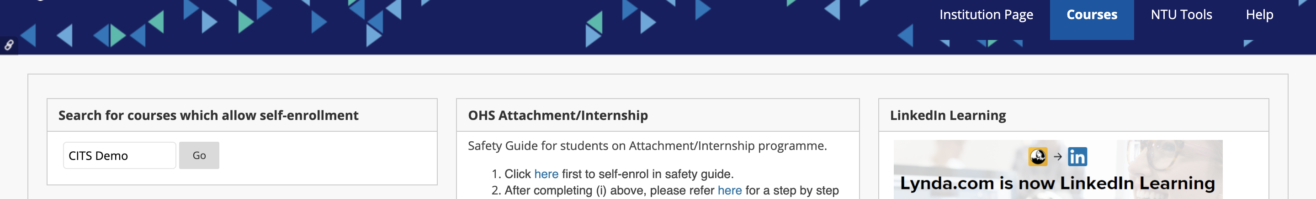
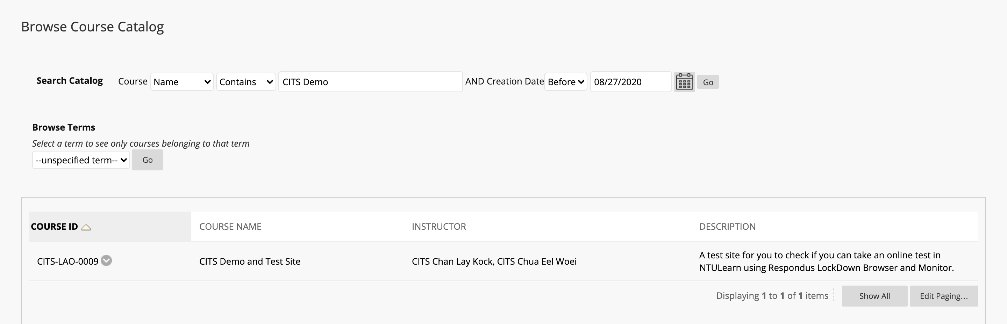
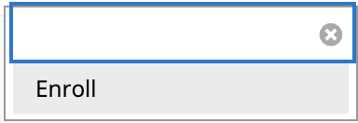
Self-enrol into CITS Demo and Test Site
Direct link to self-enrol to the course:
https://ntulearn.ntu.edu.sg/webapps/blackboard/execute/enrollCourse?context=Course&course_id=_312666_1
1. Go to the Course tab and search for ‘CITS Demo’ in the Search for courses which allow self-enrollment module.
2. Click the contextual menu next to Course ID and select Enroll.

Slide 9
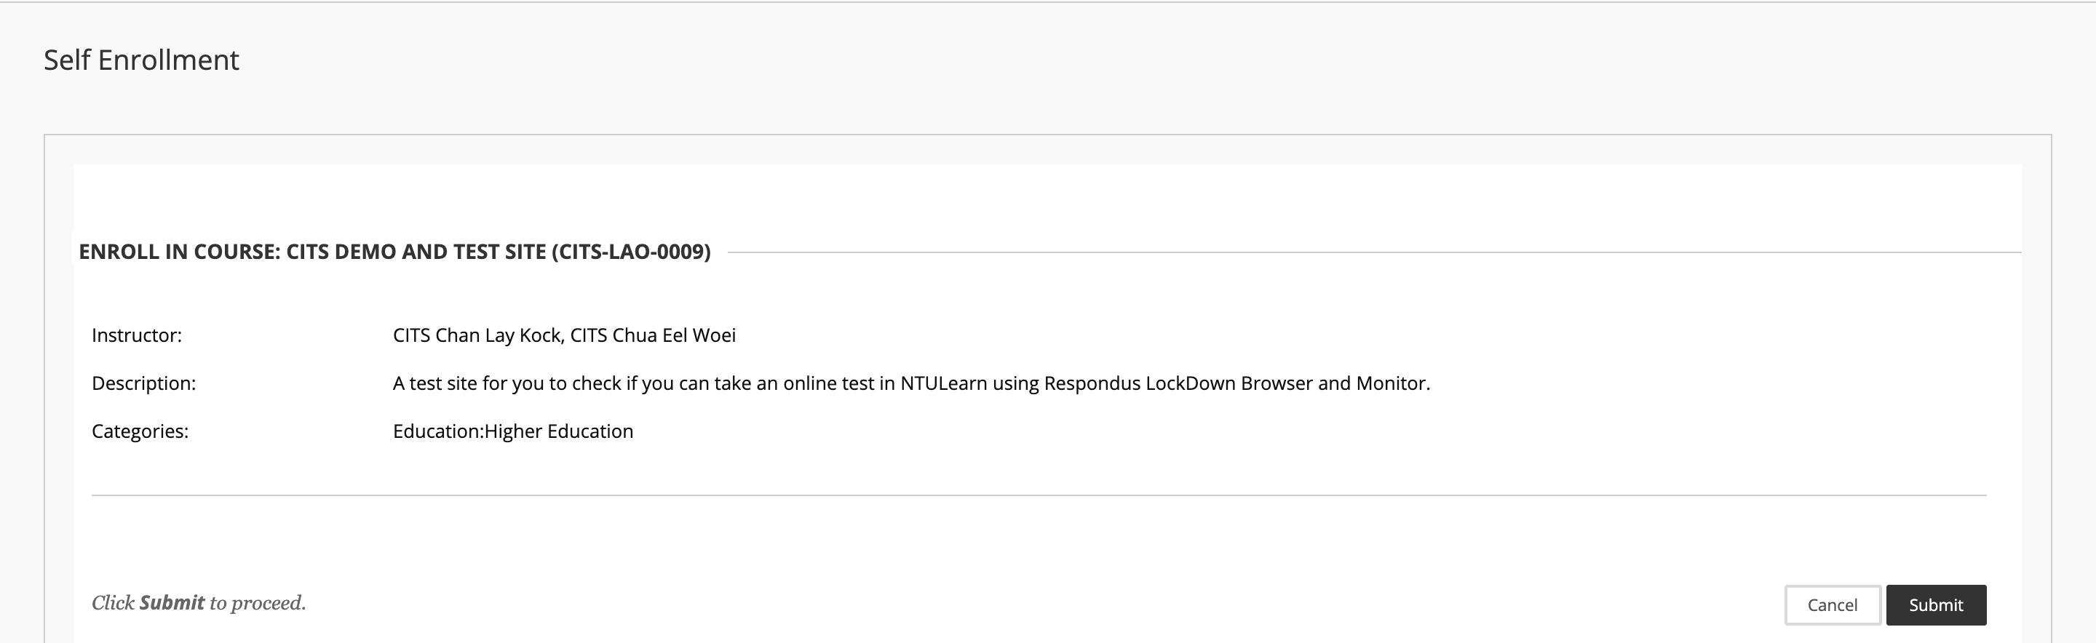
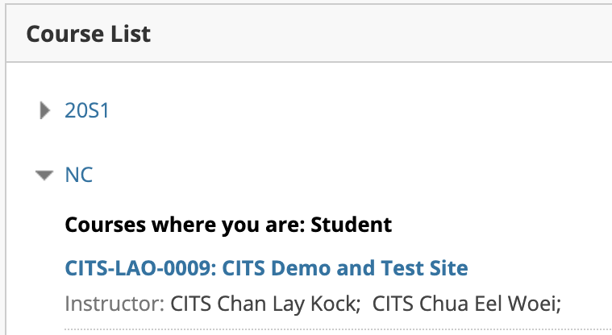
Self-enrol into CITS Demo and Test Site
3. Click Submit to enroll into the course.
4. Click the course link in the Course List module in My Institution tab to enter the course.

Slide 10
Self-enrol into CITS Demo and Test Site
3. Click Submit to enroll into the course.
4. Click the course link in the Course List module in My Institution tab to enter the course.

Slide 11
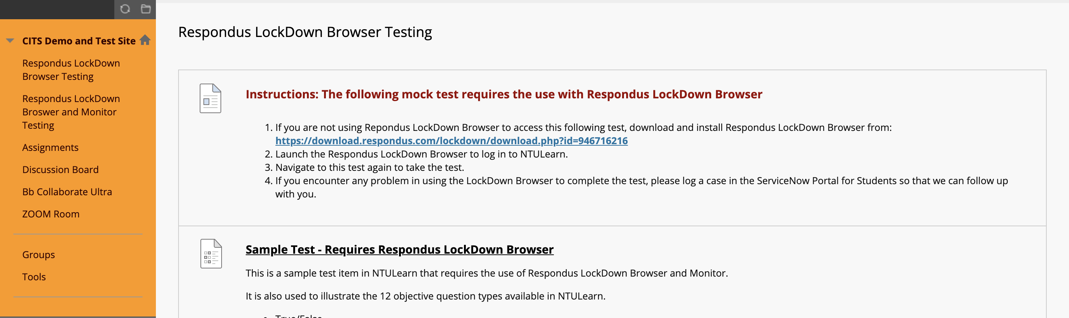
Self-enrol into CITS Demo and Test Site
5. Enter the relevant content area where the mock test is created – either require LockDown Browser or require both LockDown Browser and Monitor, to check that you are able to use Respondus LockDown browser to complete the mock test.

Slide 12
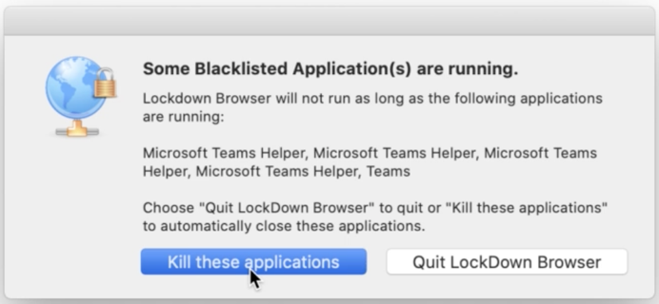
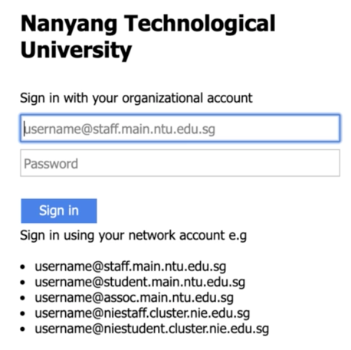
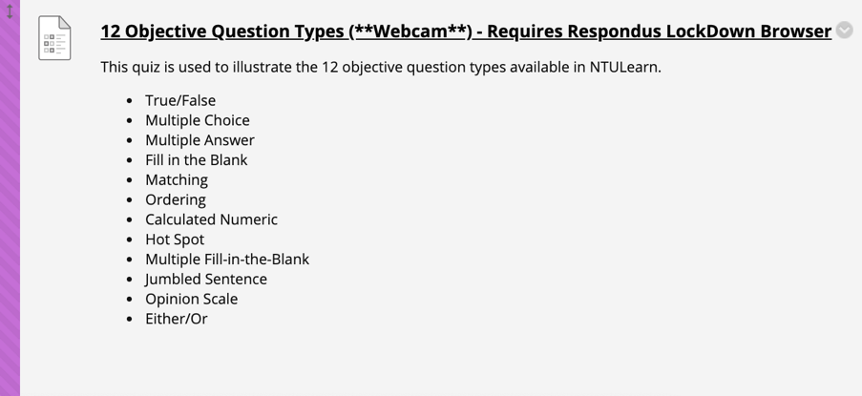
Respondus Quick e-Guide: Using Respondus LockDown Browser to take Test in NTULearn
Before launching the Respondus LockDown Browser, please close all the other applications such as Outlook, internet browsers and WhatsApp running on your computer.
4
3
3
2
Steps
Launch Respondus LockDown Browser. It will navigate to NTULearn automatically.
Click Kill these applications if the browser detects some applications that need to be closed.
Log in to NTULearn.
Browse to the course and content area where the test item is located to take the test.
Things to avoid when taking the online test:
Always use wired internet connection.
Do not launch the test more than once in another browser tab.
Do not check your grades during the test.
These actions may force submit your test attempt prematurely and your final answers may not be captured by the system.

Slide 13
Respondus Monitor Startup Sequence
If the test requires a Monitor webcam session (i.e. using the webcam and microphone on your computer to record your activities during the test), you will be required to go through a Startup Sequence to check your webcam and microphone, verify your identity and check your surrounding before you start the test. The activities may include:
Webcam Check
Additional Instructions
Guidelines + Tips
Student Photo Raking
Environment Check
Facial Detection Check

Slide 14
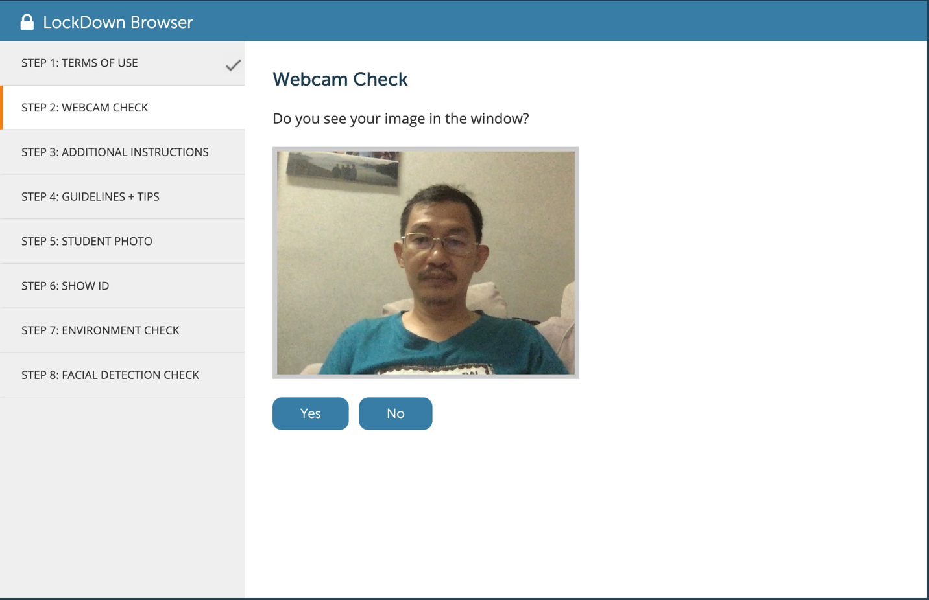
Startup Sequence: Webcam Check

Slide 15
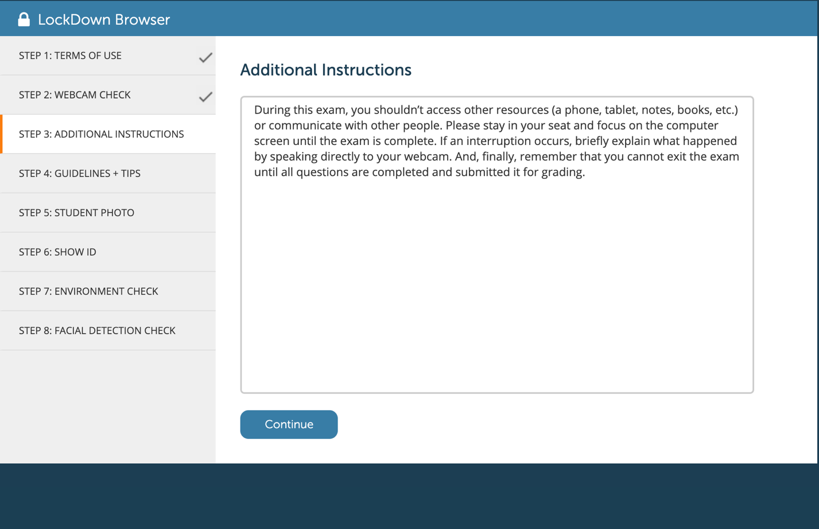
Startup Sequence: Additional Instructions

Slide 16
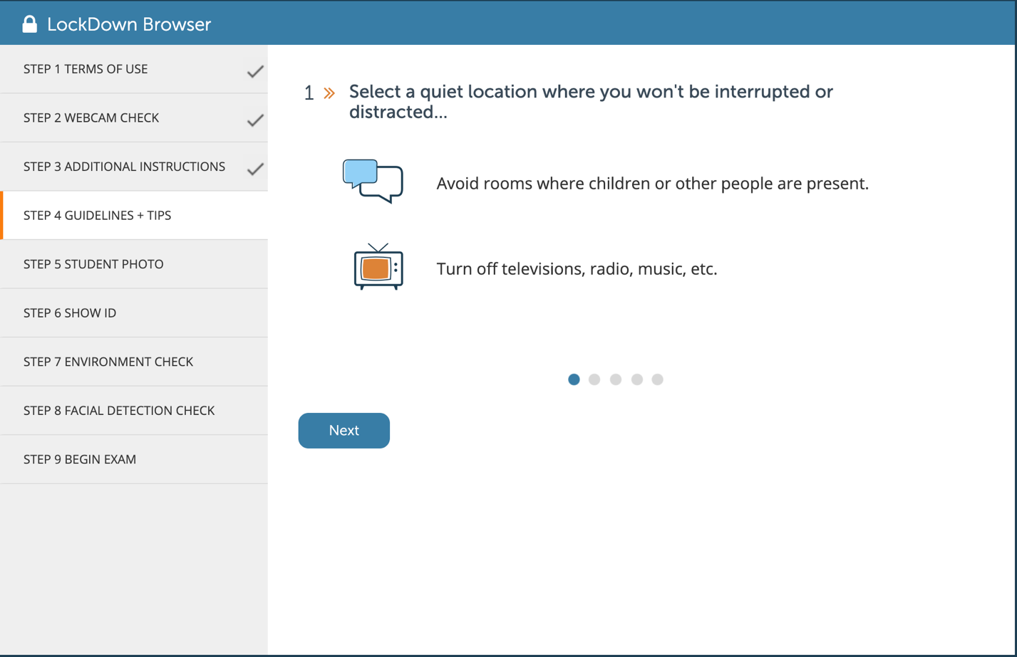
Startup Sequence: Guidelines + Tips

Slide 17
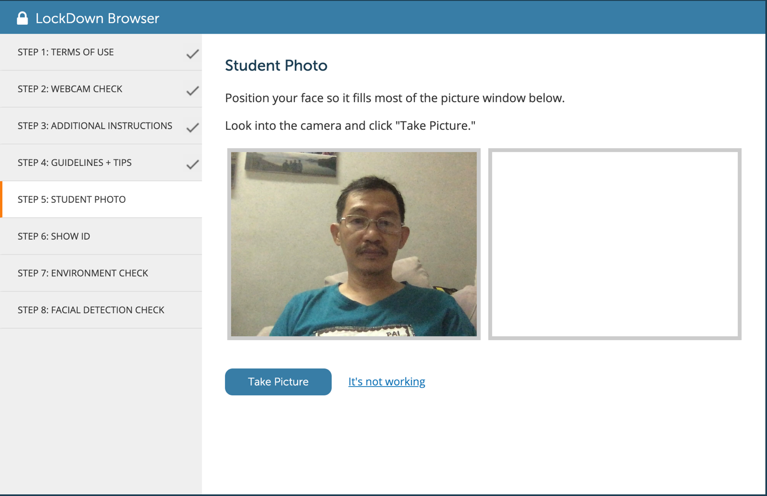
Startup Sequence: Student Photo

Slide 18
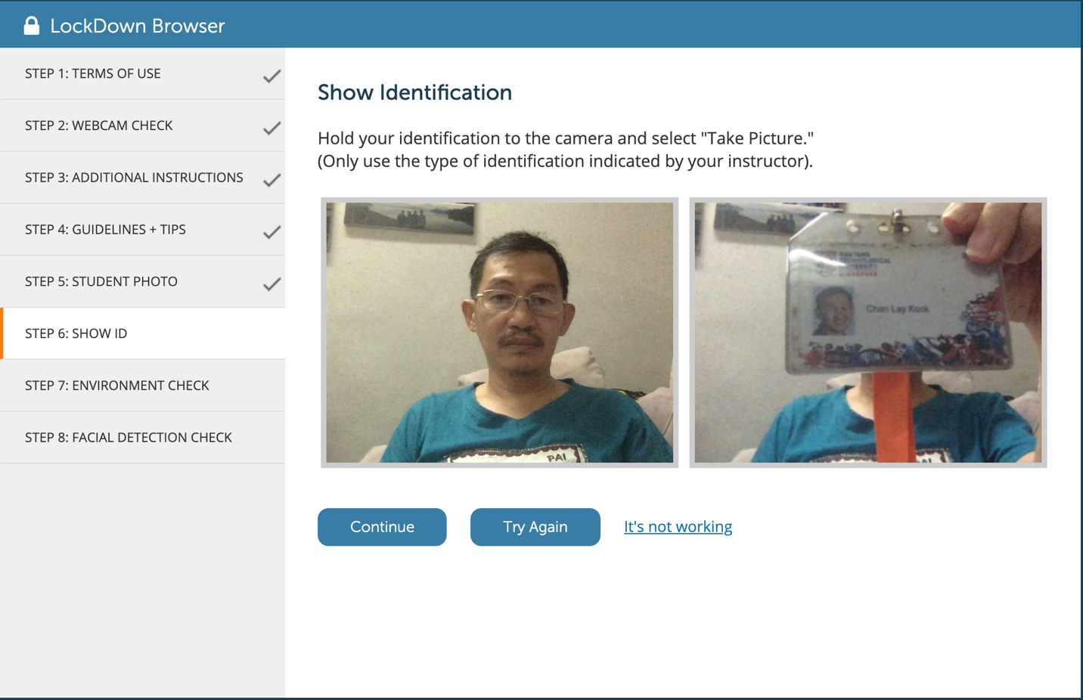
Startup Sequence: Show Identification

Slide 19
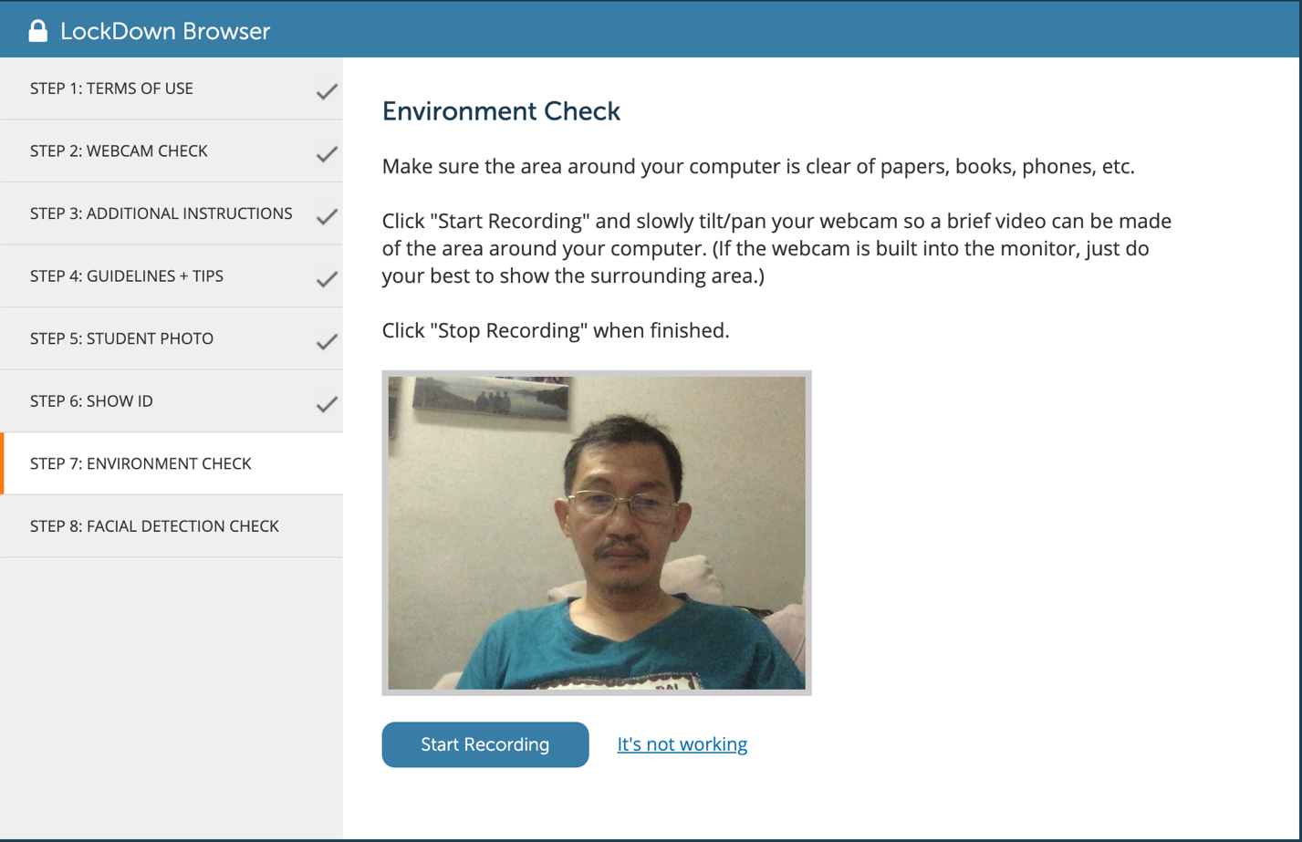
Startup Sequence: Environment Check

Slide 20
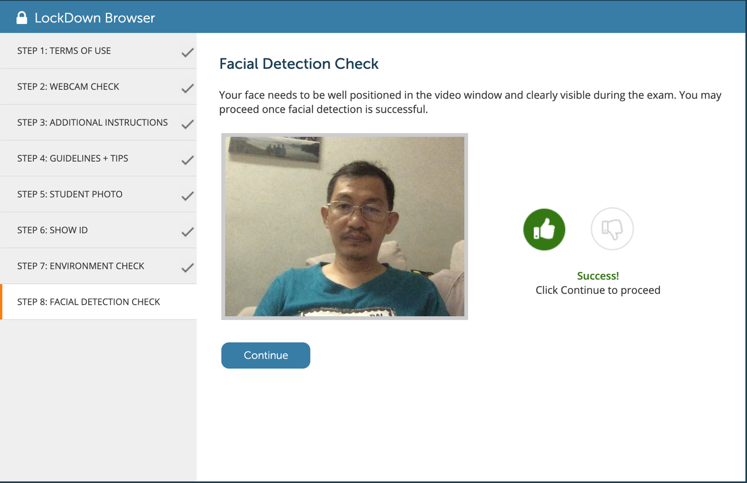
Startup Sequence: Facial Detection Check

Slide 21
2. Trouble shooting

Slide 22
Common Errors When Taking Online Test using LockDown Browser and What to Do
 | Description | Cause | Resolution
1. | Not able to log in to NTULearn using LockDown Browser as the login page is blank/not shown. | You are accessing NTU wireless network using a computer not joined to NTU domain. | Try connecting to NTUWL or NTUSecure network or your mobile data to log in to NTULearn using LockDown Brower. Desktop computer using wired internet connection to NTU network MUST be joined to NTU Staff/Student domain.
2. | Password is required to take the test | LockDown Browser is not used | Log out of NTULearn, install LockDown Browser and use it to log in to NTULearn to take the test
3. | A ‘Problem with Test Options for this exam’ error occurs when you try to start the test. | There is a problem connecting to Respondus server or the test in NTULearn has not been configured correctly. | Alert the Course Insrtructor. Take a picture of the error and note down the time when the error occurs. If the Instructor confirms that there is no issue with the test configuration, the problem would be due to your internet, firewall or anti-virus settings. Try connecting to your mobile data to log in to NTULearn using LockDown Browser. See the following guide to troubleshoot this error.
4. | The page freezes or shows a blank screen when I save the attempt or move to a new question during the test | There is a momentary loss of internet connection or connection to NTULearn server. | Log out of NTULearn and re-log in to take the test. You should be able to continue with the test.

Slide 23
Troubleshooting ‘Problem with Test Options for this Exam’ Error
The potential causes for the error are as follows:
The error is often caused by accessing the test through a "reminder" entry in a course calendar, announcement or email. It's important for you to access the test by first navigating to the course and then going to the appropriate test area or content area.
If you are sure that you are accessing the quiz following the instructions in step #1 above, the problem could be caused by security settings on your computer, ISP, or network. In most cases, the problematic settings are on the computer itself. Please do the following steps one at a time and afterwards verify if the problem persists.
Your computer, ISP, or network might be blocking access to the Respondus servers. Temporarily shut down all anti-virus and firewall software on the computer and try the exam again. If the problem persists, try using the computer on a different network, or using a different computer on your main network. Keep in mind that the block could be in the router itself. Bypassing the router and plugging straight into the modem may help.
If the error persists, reset your computer's internet options.
For Windows users, go to Control Panel and select "Network and Internet."
Once there, click on "Internet Options". On the "Security" tab, ensure that your settings are not higher than "Medium".
On the Advanced tab, click "Reset" located under the header "Reset Internet Explorer Settings".
In the window that opens, select "Delete Personal Settings" and then click on the Reset button.
Doing this will impact all client browsers, not just Internet Explorer. After resetting the internet options, restart your computer and try to access your exam again.
Ensure that you have the correct time and time zone set for your computer.

Slide 24
Online Test Rules
NO TALKING: You must observe STRICT SILENCE throughout the test.
CLEAN BACKGROUND: Your surrounding environment must be clearly seen by the invigilator.
NO UNAUTHORISED MATERIALS on your desks: e.g. books, paper, documents, pictures and electronic devices with communication and/or storage capabilities such as iPad, tablet PCs, headphones etc.
NO BREAKS! You must stay online throughout the duration of the test.
Any student found to display suspicious behaviour may be moved to a breakout room in Zoom for initial inquiries. The university takes a serious view of cheating.

Slide 25
The Test
Test duration: 1 hour. You will not be given any additional time.
… more info on the test
…
Save your work regularly. This is to avoid losing what you have typed in case of any technical glitch, wifi issues, etc.
Submission is only done ONCE, at the end of the exam. Multiple submissions are NOT allowed. The system will upload your answer at the end of the exam. attempts are NOT allowed.

